Slide 1
Applied Data Science 2
Dr Ashley SpindLer
Semester A, 2023

Slide 2
Lecture 1 - Outcomes
Get an overview of the course structure
Introduce the assessment landscape and CodeGrade
Demonstrate how to use Google Colab

Slide 3
Course Overview
Gain skills in data handling and processing with Apache Spark
Build understanding of how to develop end-to-end neural network pipelines in Tensorflow
Develop a working knowledge of how to enhance and optimise networks with GPUs

Slide 4
Course Overview – Units 2-3
Develop a working knowledge of Apache Spark for interacting with large databases
Understand how to write basic queries using PySpark
Use aggregations to extract high level insights from your datasets

Slide 5
Course Overview – Units 4-8
Get to grips with the basic operating principles of TensorFlow and Keras, and implement some simple models
Understand how to use TensorFlow and Keras to build and train simple neural networks
Demonstrate how to solve computer vision tasks with CNNs
Use recurrent networks to approach NLP tasks

Slide 6
Course Overview – Units 9-11
Create more complex models and pipelines using tensorflow datasets, customisation and understand how to optimise your models
Understand how to build efficient data processing pipelines
Use custom layers to create new functionality for your models
Demonstrate how to maximise the processing power of GPUs

Slide 7
Assessment Landscape

Slide 8
Course Overview - Assignments
Canvas Quizzes – Three quizzes worth 5%, 10% and 5%
Assignment 1 – Data Handling with PySpark – 30%
Assignment 2 – Deep Learning with Keras – 50%

Slide 9
Course Overview – Canvas Quizzes
When:
Quiz 1 – 30/10/23
Quiz 2 – 20/11/23
Quiz 3 – 11/12/23
What:
Quiz 1 – Apache Spark
Quiz 2 – Tensors and Variables
Quiz 3 – GPU Acceleration
How: 30 minute timed online quiz

Slide 10
Course Overview – Assignment 1
When:
Available 25/10/23
Due 29/11/23
What: Data Handling with PySpark
How: Python notebook submission via CodeGrade

Slide 11
Course Overview – Assignment 2
When:
Available: 30/11/23
Due: 17/01/24
What: Deep Learning with Keras
How: Python notebook + 1 page report via CodeGrade

Slide 12
Google Colab
Online platform using Jupyter notebooks and cloud computing

Slide 13
Google Colab
Colab, or ‘Colaboratory’, is a platform that runs Jupyter notebooks. As the service is hosted online, it requires very little configuration. Colab also provides free access to GPUs, and comes with many ML related python modules readily available.

Slide 14
Google Colab
You’ll be introduced to Colab in the first practical, but the main thing to remember is it works almost exactly like a Jupyter notebook, without the hassle of managing python environments.

Slide 15
Google Colab
For the PC labs, you will be provided with a Colab Notebook via canvas. Download the notebook into your Google Drive, and you’ll be able to open your own copy of it in Colab.

Slide 16
Google Colab
For the assignments and code quality assessments, you’ll be asked to submit your notebooks to canvas.

Slide 17
Google Colab
”Can I just use Conda instead and submit my .py scripts?”

Slide 18
Google Colab
”Can I just use Conda instead and submit my .py scripts?”
No.

Slide 19
Google Colab
”Can I just use Conda instead and submit my .py scripts?”
No. Colab ensures everyone is using the same environments, with the same versions of python and modules.
Your Colab scripts can be assessed without needing access to a python environment or a GPU
The tutorial sheets and assignments will be supplied to you in Colab Notebooks

Slide 20
Colab in Tutorials
Each tutorial has a colab notebook containing the exercises to be completed
You should download the tutorial notebook prior to your timetabled lab and save it in your google drive

Slide 21
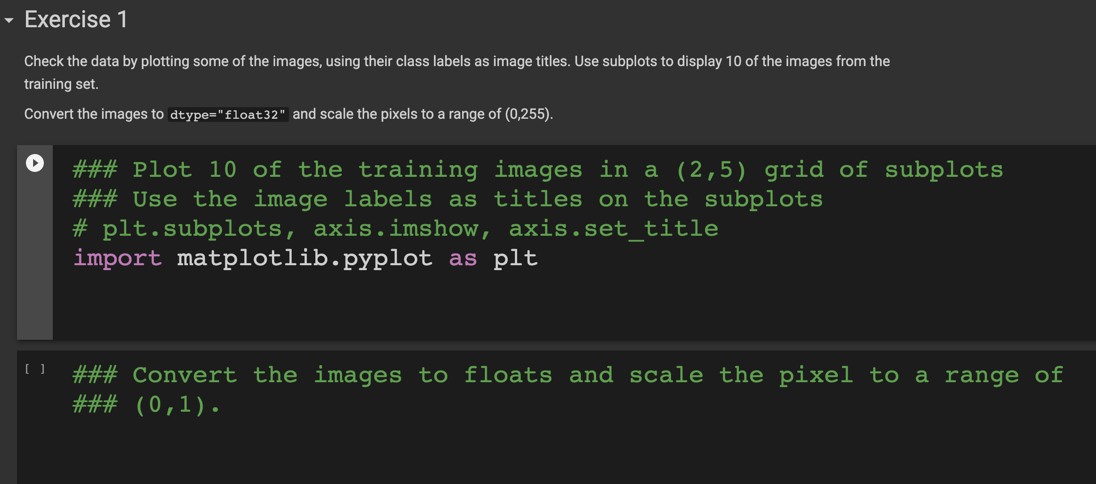
Tutorial Example
Exercise Description
A triple hash (###) denotes a Specific Instruction
Recommended functions and methods

Slide 22
Colab and Assignments
For each of the coding assignments, you will be provided with a Colab Notebook via the assignment page
Use of these notebooks is MANDATORY
Submissions that do not use the template notebook will receive 0 marks for coding portions of the assignment

Slide 23
CodeGrade
Automated grading software for coding assignments

Slide 24
What is CodeGrade?
CodeGrade is a piece of software that is integrated into the Canvas Learning Environment.
It is designed for coding assignments and includes numerous tools for automatically grading python submissions.

Slide 25
How is it different to Canvas?
When you open one of the CodeGrade assignments on Canvas, it will open an interface window where you can submit your work.
You will be able to upload your files to CodeGrade, and view the results of the autograder as soon as it is finished (but not your grades).
Module staff can also leave feedback on your submissions, and you will have the chance to resubmit before the final deadline.

Slide 26
More details on CodeGrade to come when the first assignment goes live.

Slide 27
Questions???

